Slide 1
college data management systems SUPERSIX
DATABASE MANAGEMENT SYSTEMS
DR.REZASADEGHI
SPRING 2023

Slide 2
ABOUT US
We are a team of highly motivated and skilled individuals who have come together to achieve greatness. Our team is made up of six members, each with a unique set of talents and expertise, and we work together to deliver exceptional results.
Our mission is to provide the best possible solutions, whether it be in the field of technology or business development. We believe that by working together, we can achieve more than any individual can on their own.

Slide 3
Meet our Team
Pradeep Reddy Baireddy
Prajakta kshirsagar
I have a bachelor's degree in computer science and two years of experience as a front-end developer for Ecommerce sites. Our project aims to cover different scenarios in development and enhance our teamwork skills.
I'm a computer science graduate with 3 years of experience in banking and finance. Our project aims to showcase each member's talent and utilize their skills and knowledge to their fullest potential.
Deepthi Niharika Gadepalli
Bharadwaja Thota
I have a Bachelor's in Electronics and Communication Engineering. Our project focuses on DBMS, and I expect to learn a lot through collaboration and research, benefiting my future professional life.
I have a background in Information Technology and joined this team because I know my teammates from previous projects and feel comfortable sharing ideas.. I believe we can work together effectively under his leadership.
Pradeep Reddy Macha
Chakradhar Reddy Marepally
I'm a Telecommunications Engineer with a strong background in Electronics and Communication Engineering and Information Systems. With 3 years of experience at Gigacomm. I joined this team project to learn and share knowledge with members of diverse skills and perspectives.
I completed my graduation in electronics and communication engineering from JNTUH in 2021. Eagerly waiting to do work in all fields. I am interested to learn new things.

Slide 4
Project OVERVIEW
Entity Relationship
Enhanced Entity Relationship
Database Development
Loading Data & Performance Enhancements
Application Development
Graphical User Interface Design
Future Enhancements

Slide 5
Projective objectives
Create a user-friendly and efficient student information system.
Keep a track of performance of progress of student and faculty
Streamline management of user data
Improve data accuracy and accessibility
Enchance administrative efficiency

Slide 6
Entity Relationship
An ER diagram is a visual representation of entities, attributes, and relationships in a database. it helps to show how different pieces of data are related and organised, making it easier to understand the database structure. an er diagram is a visual representation of entities, attributes, and relationships in a database. it helps to show how different pieces of data are related and organised, making it easier to understand the database structure.

Slide 7
Entities
Student
Faculty
Courses
Programs
Sessions
Departments
Admissions
Grades and Attendance
Student_info
Hostel

Slide 9
Entity Relationship
Our Entity Relationship Diagram (ERD) developed using ERDPlus.
Partial participation relationship between Hostel and Student entities.
Total participation relationship between Student and Student_info entities.
Composite name attribute in Student entity.
Multivalued mail and phone number attributes in Student_info entity.
Derived age attribute in Student entity.
Weak entities: Student_info and Grades and Attendance, related to the Student entity.
Strong entities: Student, Program, Course, not relying on other entities for representation and identification.
One-to-many relationship between Student and Program entities.
One-to-one relationships between Student and Admissions, Student and Student_info entities.
Many-to-many relationship between Faculty and Sessions entities.
Student and Student_info entities in identifying relationship, as Student_info does not have a unique identifier.
Admission and Student entities in non-identifying relationship, both can be represented uniquely without dependency

Slide 10
Enhanced Entity Relationship
EER is an extension of the ER (Entity-Relationship) model used in database management systems. It provides additional features and constructs for modelling complex data relationships.

Slide 11
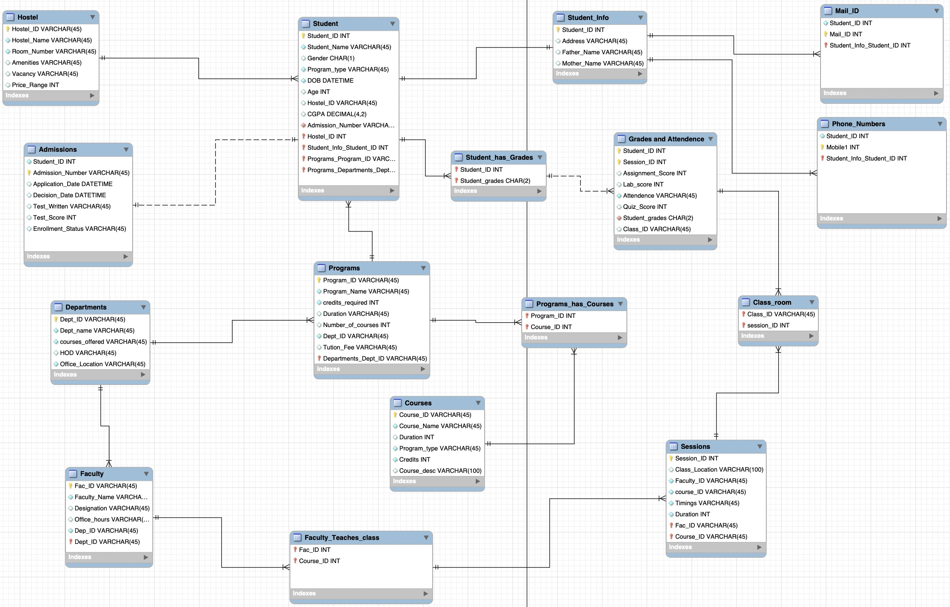

Slide 12
Enhanced Entity Relationship
Created EER diagram using MYSQL Workbench.
Added data types to each attribute in the EER diagram.
Included primary and foreign keys in the EER diagram to link tables and establish relationships.
Created separate tables for multivalued attributes
Junction tables were created from many-to-many relationships.
Clear naming conventions were used for tables, columns, and relationships.
Layout is clean and well-organised.
Conveys overall structure of the database, including relationships and keys.
Easy to understand and communicate with team members.

Slide 13
Database Development
A database is a collection of organised and structured data stored in one or more tables, which are related to each other by common attributes or keys. It is a software system designed to manage, store, retrieve, and update data efficiently and securely

Slide 14
Database Development
Developed database in SQL using EER diagram as a guide.
Hosted the database locally on our computer (localhost) for development and testing.
Created tables using SQL commands to define table structure, attributes, and data types.
Set primary and foreign keys to establish relationships between tables.
Defined constraints and indexes to ensure data integrity and improve query performance.

Slide 15
Loading Data & Performance Enhancements
Tested the database by adding, modifying, and deleting records.
Disabled foreign key constraints temporarily by setting foreign_key_checks to 0 to avoid conflicts during data insertion.
Used bulk row insertion instead of single row insertion to optimize data insertion.

Slide 16
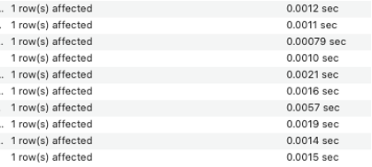
insertion
single row insertion
bulk row insertion

Slide 17
For better understanding let’s take a quick demo of sql commands and code in MYSQL Workbench.
file:///Applications/MySQLWorkbench.app/

Slide 18
Normalization
What is normalization?
The process of organizing data in a database to reduce data redundancy and improve data integrity
Why is normalization important?
Minimizes data inconsistencies and anomalies that can arise when updating or deleting data in the database

Slide 19
Normalization
1NF
2NF
3NF
Ensures that each table cell contains a single, indivisible value and each column has a unique name.
The database must be in 1NF. Eliminates data redundancy by ensuring that all non-key attributes are fully functionally dependent on the primary key.
The database must be in 2NF. Minimizes data redundancy by ensuring that each non-key attribute is dependent only on the primary key and there are no transitive dependencies between non-key attributes.

Slide 20
Application Development
GUI application development using Python's Tkinter library and MySQL database involves creating a graphical user interface to interact with the database. Tkinter is a standard GUI library for Python that provides a set of widgets to create GUI applications.

Slide 21
Pages in application design
Pages refer to individual screens or views within a GUI for a database
Each page typically has a specific purpose or function
Pages may display different sets of information or options for the user to interact with
Pages are designed to be visually cohesive and user-friendly
Navigation between pages is usually intuitive and easy to use
Well-designed pages can enhance the user experience and make it easier to manage the database.

Slide 22
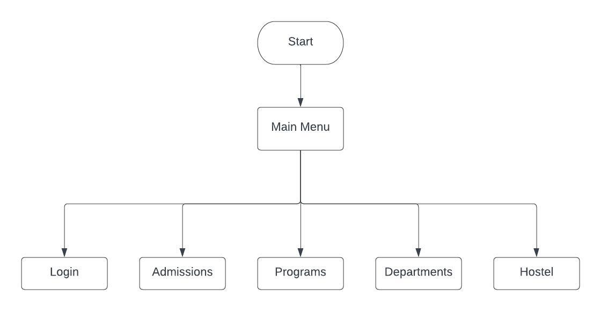
Main Menu
Login

Slide 23
Faculty login
Student Login

Slide 24
Departments
Admissions

Slide 25
Faculty
Programs

Slide 26
Courses

Slide 27
Views Implementation
A view in MySQL Workbench is a virtual table that displays the results of a SELECT statement.
Views can be created based on one or more tables, and can include aggregate functions, subqueries, and joins.
Views offer convenience by allowing users to retrieve data from multiple tables without writing complex SQL queries.
Views provide an additional layer of security and data abstraction, as they allow users to access a portion of the data without direct access to the underlying tables.
Views are read-only and cannot be used to modify data directly.
Views can impact database performance, as they may require additional processing time to generate data.
Views can be created, edited, modified, and dropped in MySQL Workbench.

Slide 28
For better understanding let’s take a quick demo on Views implementation.
file:///Applications/MySQLWorkbench.app/

Slide 29
Graphical User Interface Design
GUI design for a database refers to the process of creating a visual interface that allows users to interact with a database system through icons, menus, buttons, and other graphical components. The main goal is to make the system easy to use, efficient, and effective. It involves designing the layout, colours, and other visual elements that make up the user interface to ensure usability, functionality, and aesthetics.

Slide 30
Connecting database
Code connects to a MySQL database and displays a success or error message based on the connection.
Login page asks for username and password, checks against MySQL database, and displays a success or error message.

Slide 31
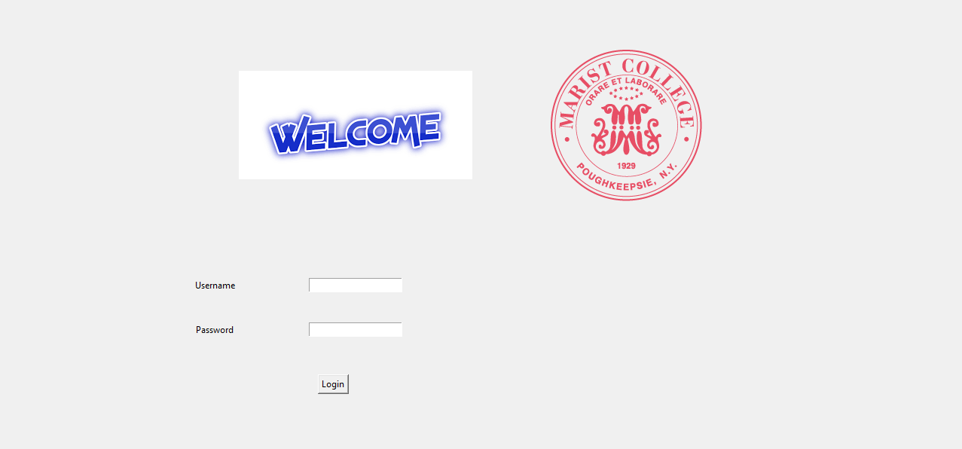
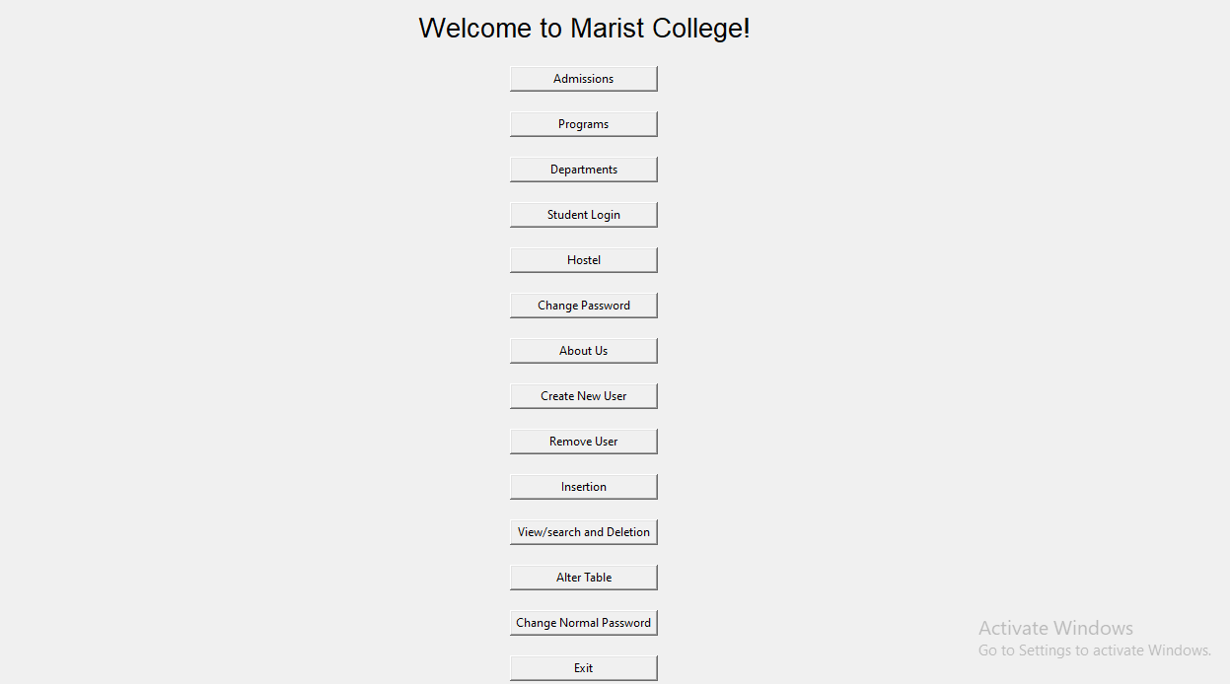
Action pages
Login page
Main Menu Page

Slide 32
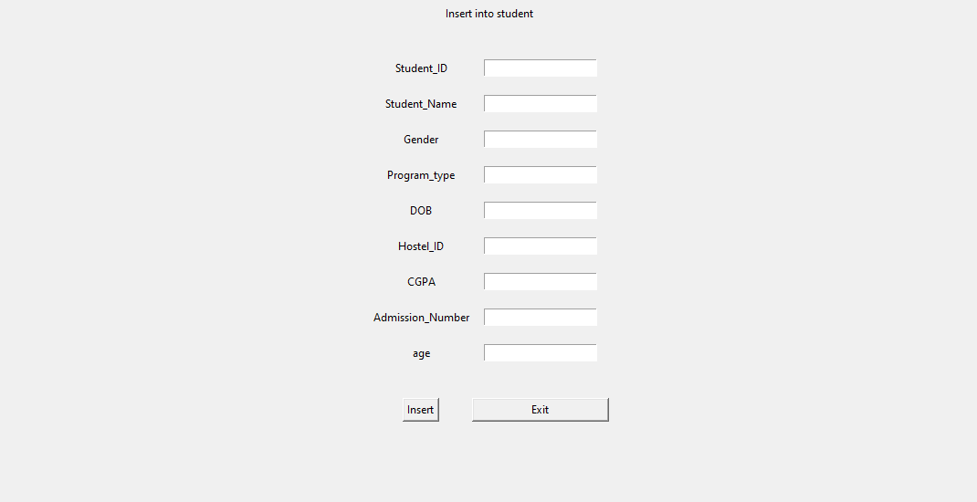
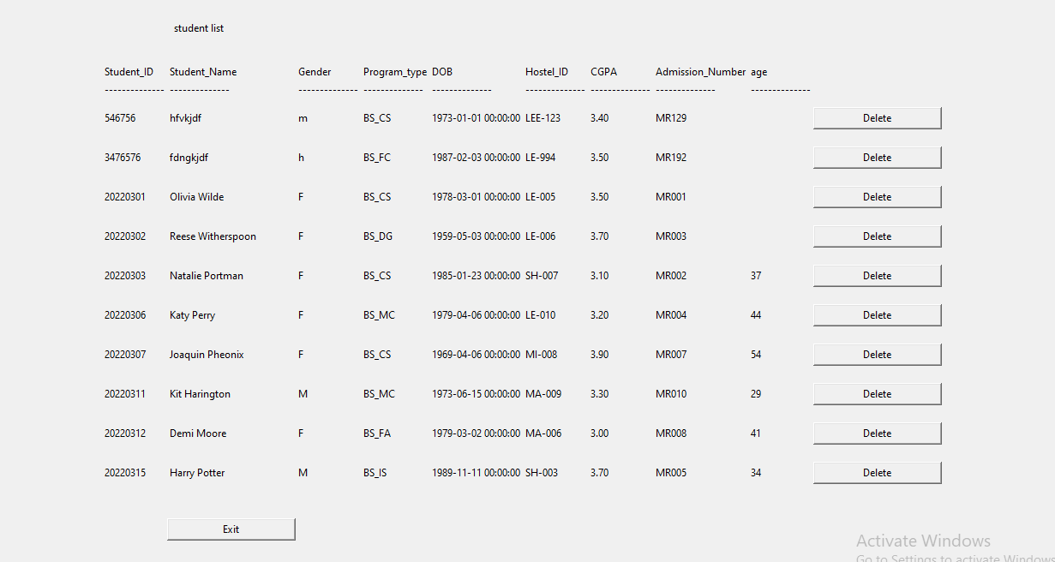
Action pages
Insertion Page
View Page

Slide 33
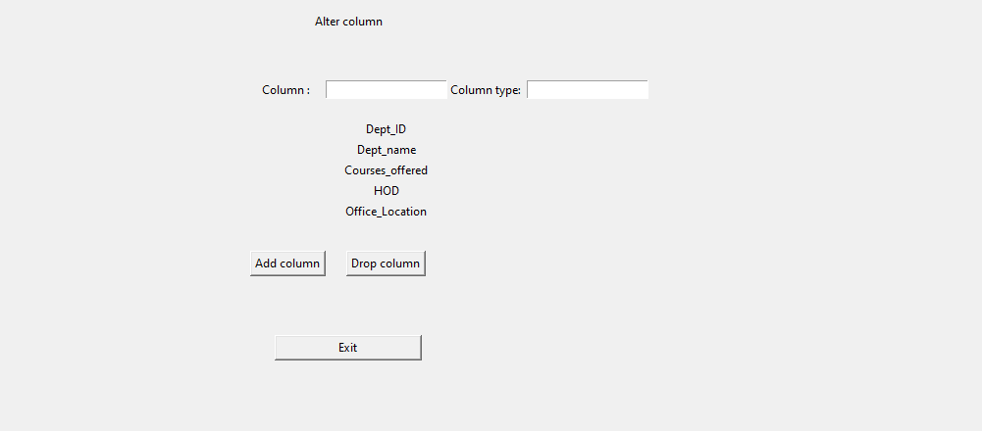
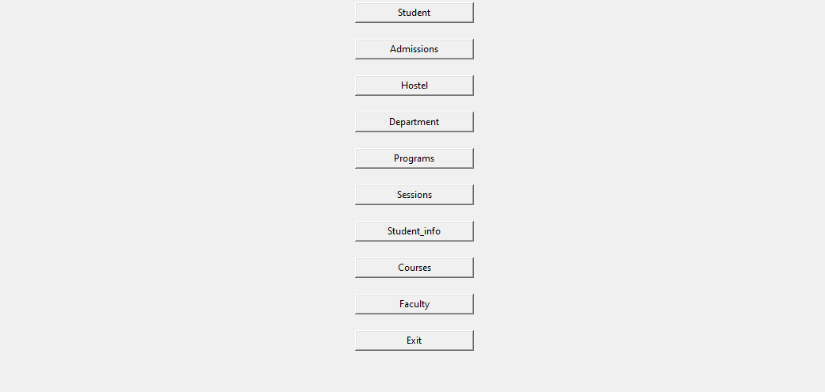
Action pages
Modification Page
Deletion page

Slide 34
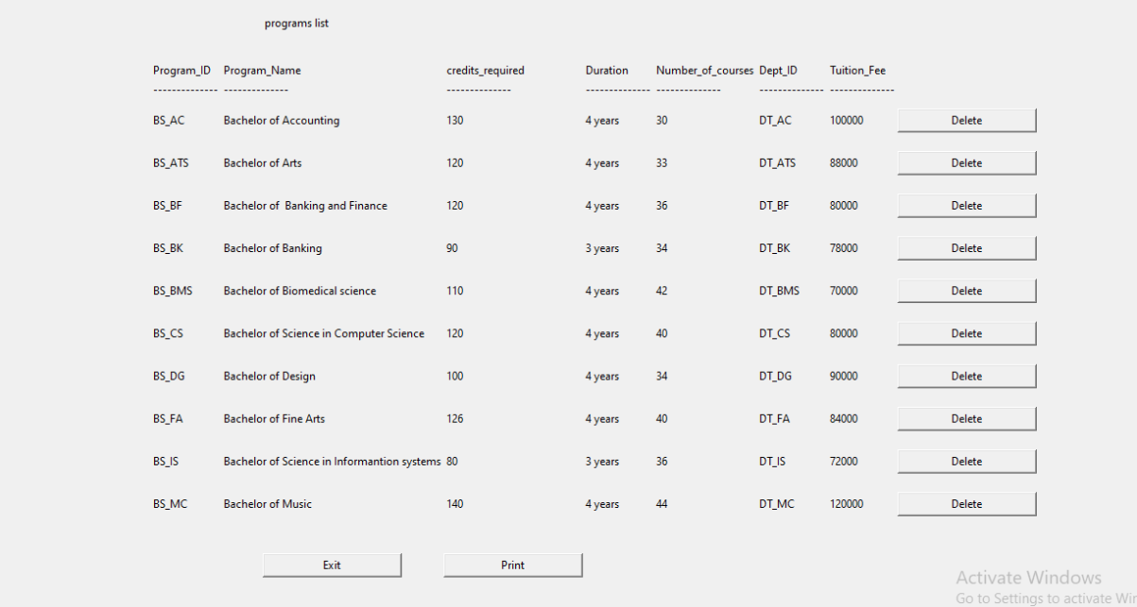
Print data

Slide 35
Action pages
Insertion page creates a form to insert data into a specified database table, clears the window, and displays entry fields for each column. It inserts data if successful and displays a message box.
Modification page creates a form to add or remove columns from a database table, with input boxes for column name and type and displays existing columns as labels. It has buttons for adding, removing, and exiting the page.
Delete function deletes a row from a database table using the input ID, displays a success message box if successful, and prints an error message otherwise. It temporarily disables foreign key checks.
Print page function creates a new frame to display data from a specified database table, displays column names and data as labels, adds a delete button for each row, and has buttons to print the data and exit the page.

Slide 36
For better understanding let’s take a quick demo of GUI on python
../Visual Studio Code.app

Slide 37
Key Takeaways
Learned how to create effective Entity Relationship (ER) models and Enhanced Entity Relationship (EER) models
Gained knowledge on converting EER models into schema and developing databases using these models
Discovered techniques to ensure data integrity and avoid data redundancy
Acquired skills on using SQL commands in practice to manage databases effectively
Learned to develop Graphical User Interfaces (GUI) using the Python Tkinter module
Skills and knowledge gained from this project will be useful throughout our professional lives.

Slide 38
Future Enhancements
Integrate a calendar feature to view important academic dates
Add additional user roles such as staff and alumni for better access management
Enhance security with features such as two-factor authentication and encryption of sensitive data
Create a mobile app version of the application for on-the-go access
Implement email notifications to remind users of upcoming deadlines and important updates
Add reporting and analytics capabilities to track student performance and make data-driven decisions.

Slide 39
References
https://erdplus.com/standalone
file:///Applications/MySQLWorkbench.app/
https://lucid.app/documents#/documents?folder_id=recent
Visual Studio Code.app

Slide 40
THANKs Everyone

